Slide 1





Lesson 7:
Knock, knock!
Knock,
knock!
Who’s
there?

Slide 2
Slide

Slide 3
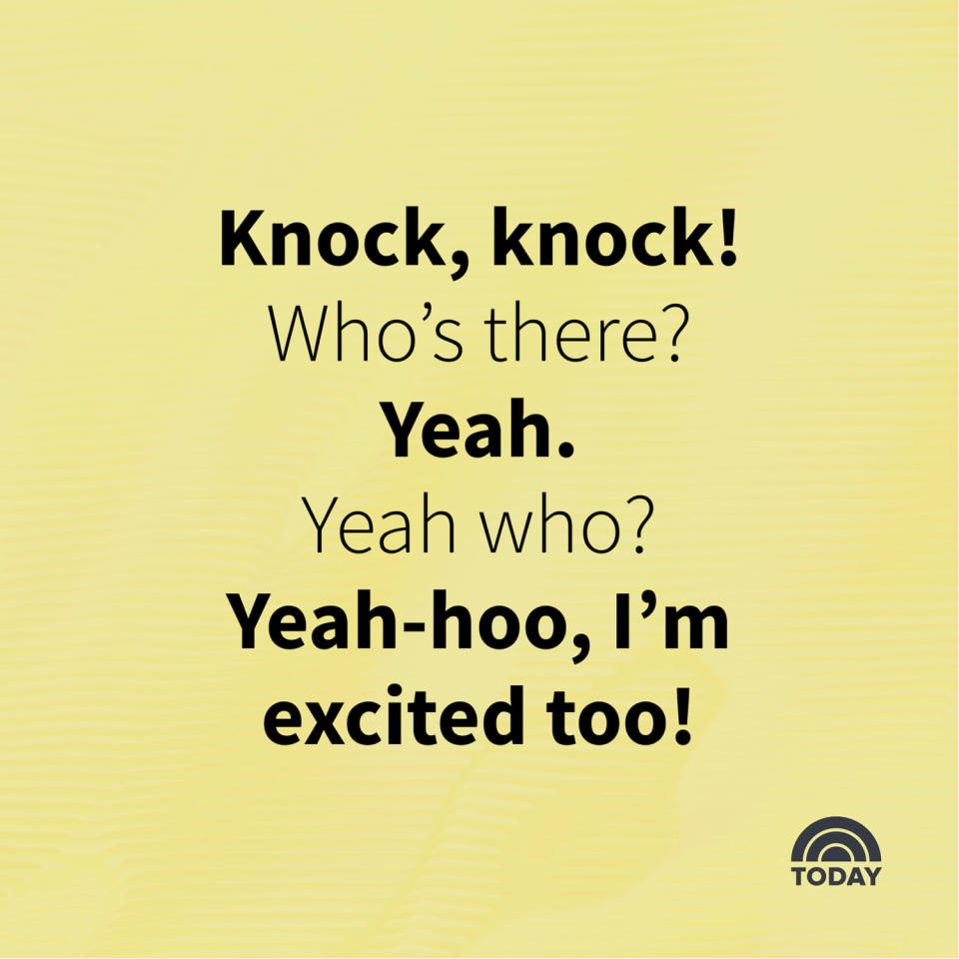
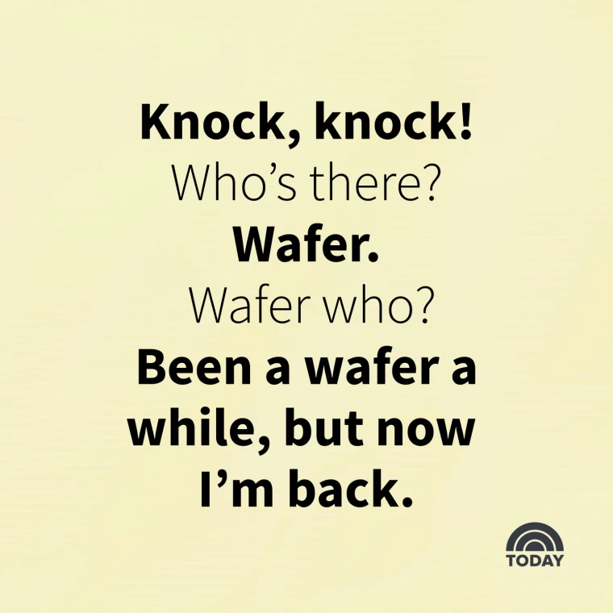
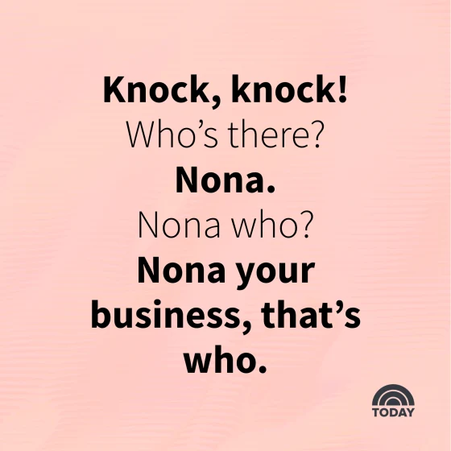
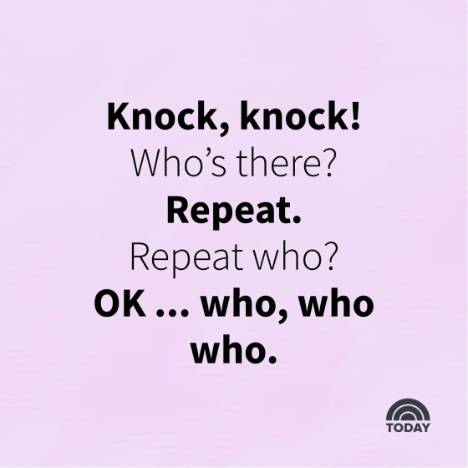
Knock-knock Jokes

Slide 4
Knock-knock Jokes
Place to find more knock-knock jokes:
www.today.com/life/inspiration/knock-knock-jokes-rcna44380

Slide 5


Our Joke
Knock,
knock!
Who’s
there?

Slide 6


Our Joke
Yeah Who?
Yeah!

Slide 7

Our Joke
Yeah-hoo! I’m excited too!

Slide 8


Backdrop

Slide 9
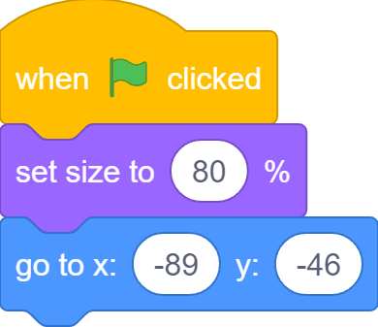
Sprites
First Dinosaur: Dino1

Slide 10
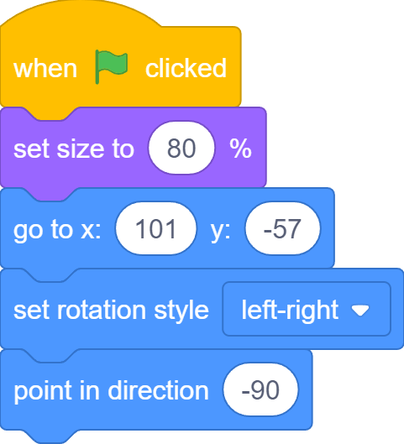
Sprites
Second Dinosaur: Dino2

Slide 11
The Stage is Set!

Slide 12
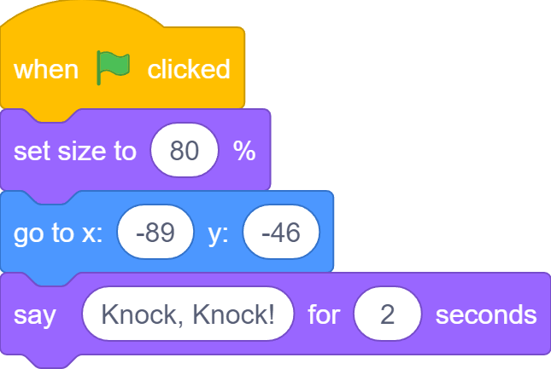
“Knock, knock!”
Knock, knock!

Slide 13
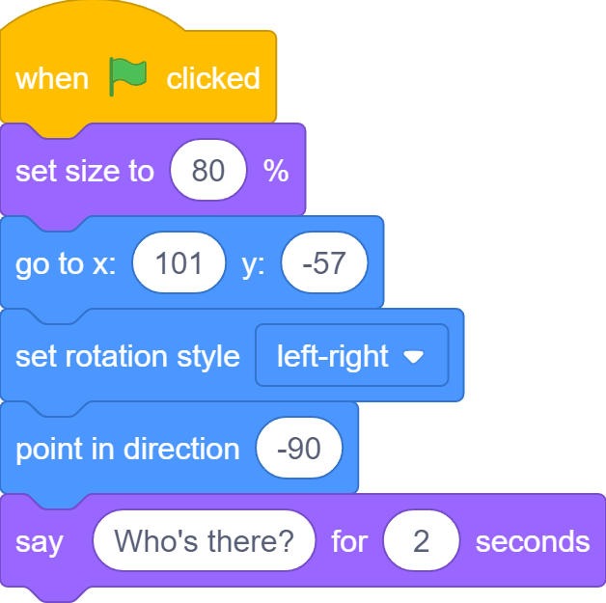
“Who’s there?”
Who’s there?

Slide 14
You’re Speaking Over me!
Knock, knock!
Who’s there?
Dino2 starts to speak before Dino1 has finished!

Slide 15

Dino2: Ok, I’ll Wait
Knock, knock!
Who’s there?

Slide 16
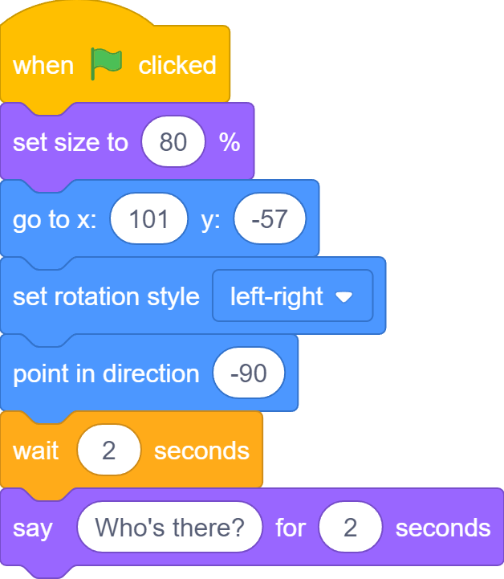

Dino2: Ok, I’ll Wait
Who’s there?

Slide 17
Say-and-Wait
Knock, knock!
Yeah!
Yeah-hoo! I’m excited too!
Time goes this way!
Who’s there?
Yeah who?

Slide 18
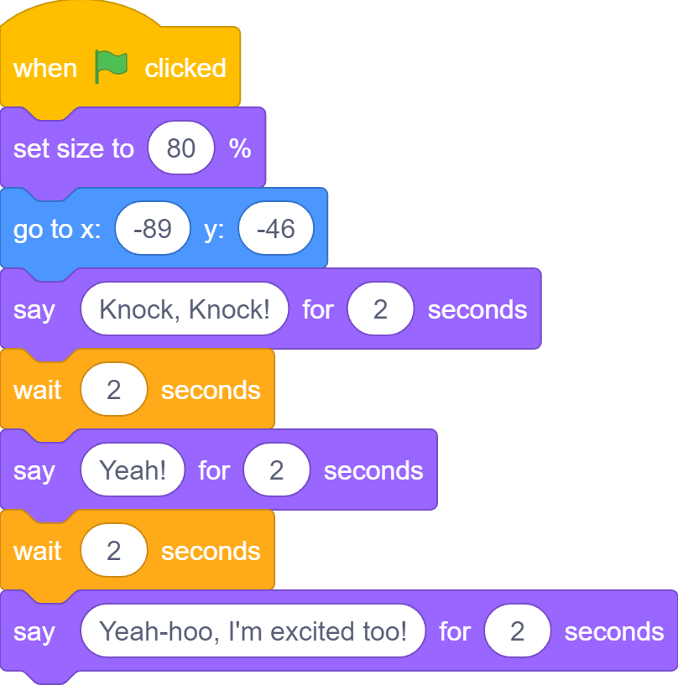
Say-and-Wait

Slide 19
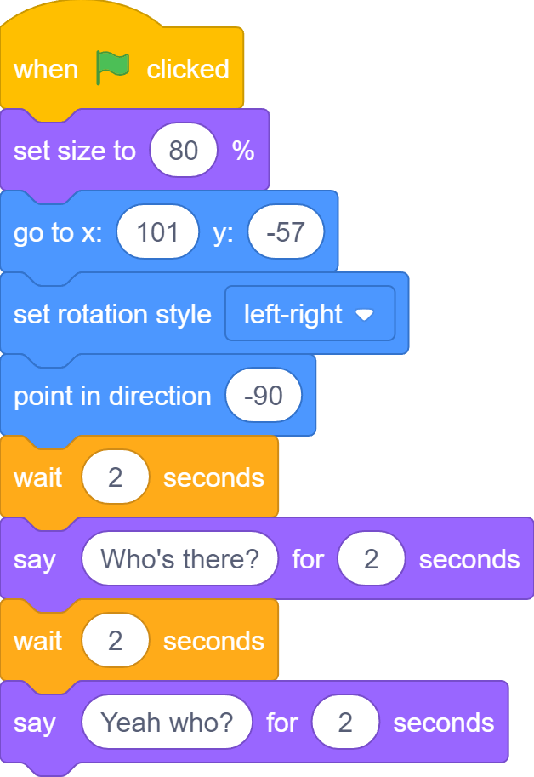
Say-and-Wait

Slide 20

What If…
What if Dino1 changes this from 2 seconds to 4 seconds?

Slide 21

What If…
Dino2 needs to wait from 2 seconds to 4 seconds here

Slide 22



What If…
… in a very long conversation …
… can you easily find which wait block to update in the other sprite?
…
…
… a say block of one sprite changes to 4 seconds …
Sprite1
Sprite2

Slide 23
A More Serious Problem…
What we have with the Say-and-Wait approach is NOT a real conversation at all!
In a real conversation, each side should hear what the other says before replying. But…

Slide 24
A More Serious Problem…
Knock, knock!
Yeah!
Yeah-hoo! I’m excited too!
Time goes this way!
Dino1 can says all its lines even when Dino2 does not exists!

Slide 25
Say-and-Wait
Similarly, Dino2 can says its lines even when Dino1 does not exists!
Time goes this way!
Who’s there?
Yeah who?

Slide 26
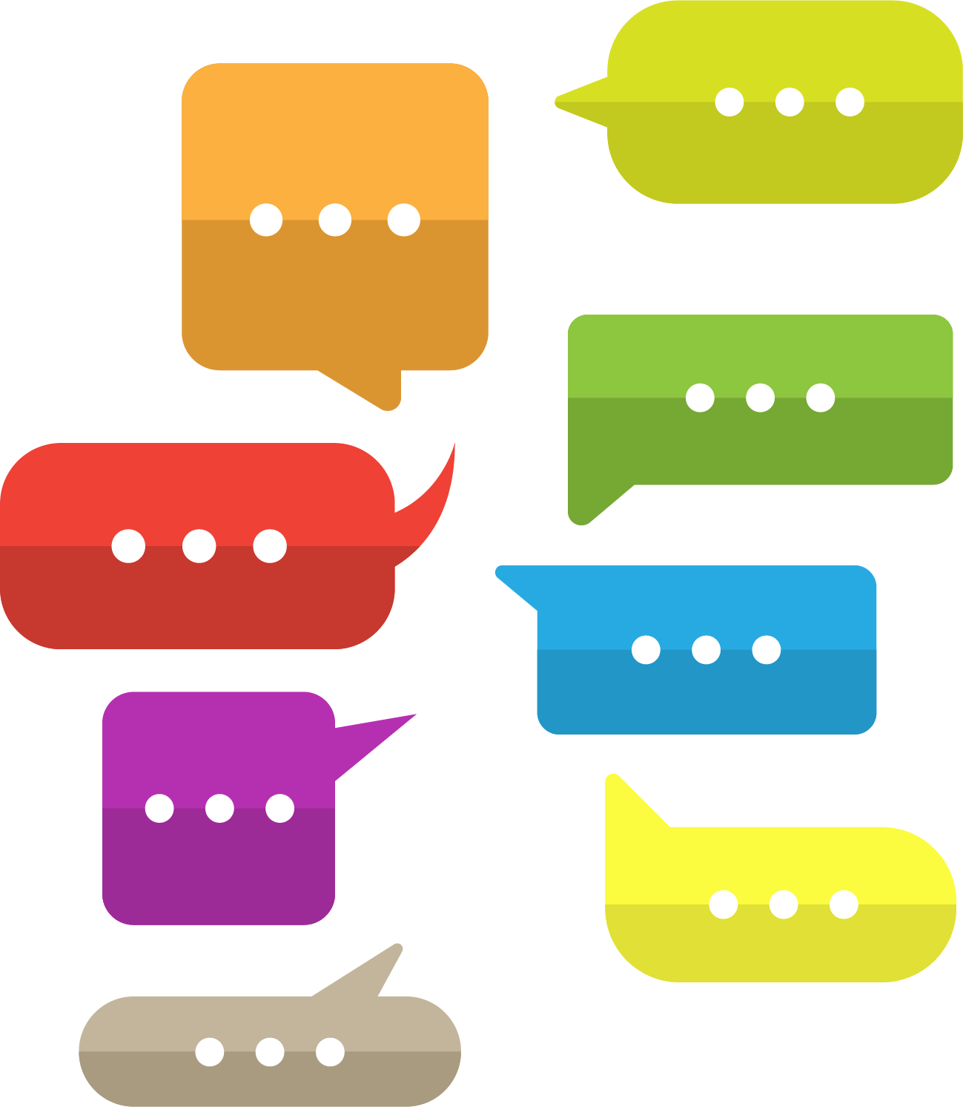


Message Exchange
Any conversation between two sides is essentially message exchanging

Slide 27
Message Exchange
Yeah-hoo! I’m excited too!
Knock, knock!
Yeah!
Who’s there?
Yeah who?

Slide 28


One-to-One

Slide 29
Broadcast

Slide 30


Messages in Scratch are Broadcasted
Assuming we have two more dinosaurs
Knock, knock!
Knock, knock!
Knock, knock!
Knock, knock!
Whoever broadcasts the message gets it back too!

Slide 31


Broadcast Message

Slide 32
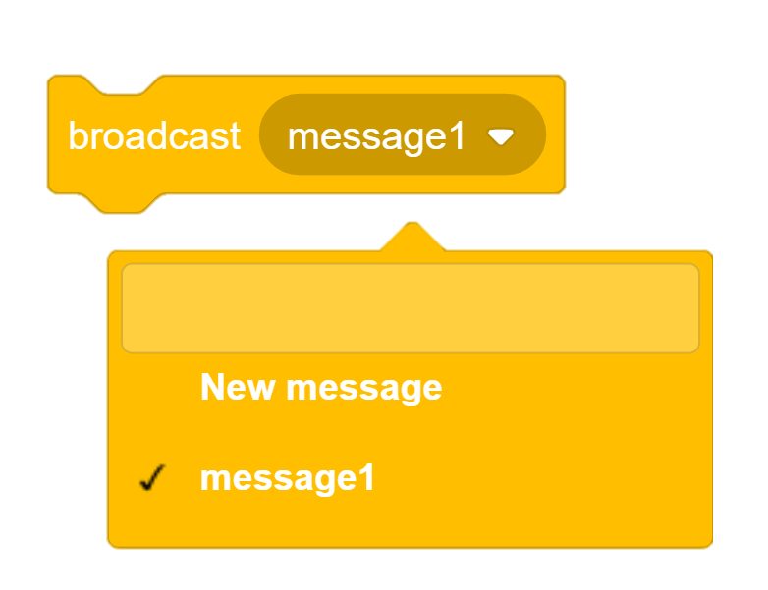
New Broadcast Message
Create your own new message with this option

Slide 33
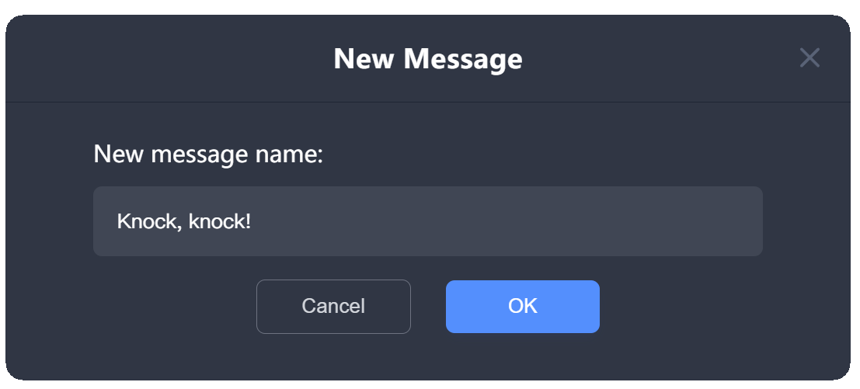
Create ”Knock, knock!”

Slide 34
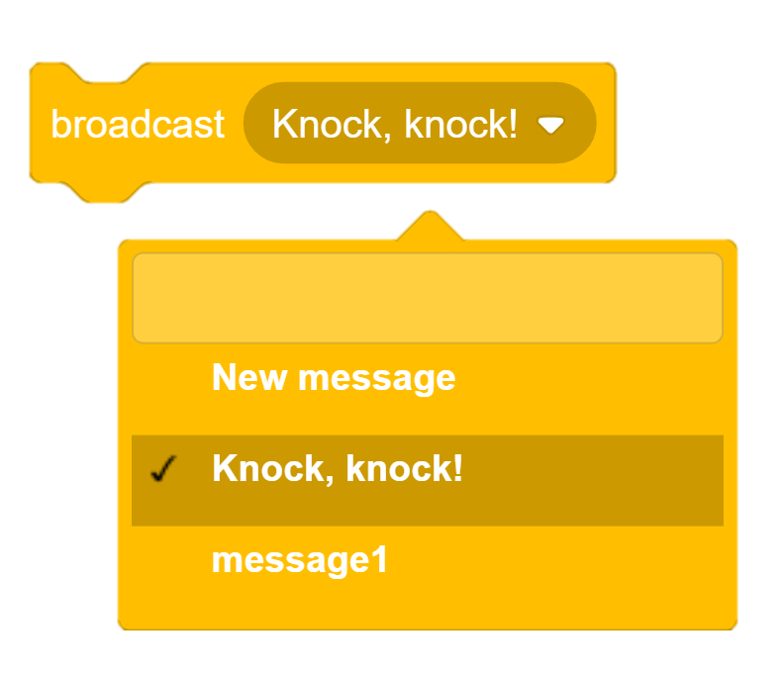
Broadcast “Knock, knock!”
New message “Knock, knock!” has been created and can be broadcasted to Dino2

Slide 35

I’m Not Listening!
Just because you broadcast it does not mean I have to listen to it!
Knock, knock!

Slide 36
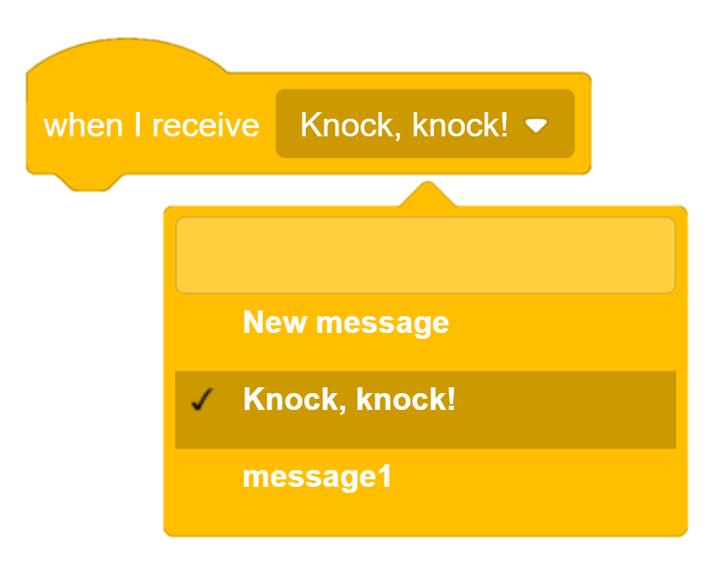
Receive Broadcasted Message

Slide 37
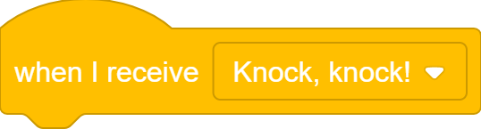
I’m Listening!
Now, I’m ready to receive your “Knock, knock!” message!
Knock, knock!

Slide 38
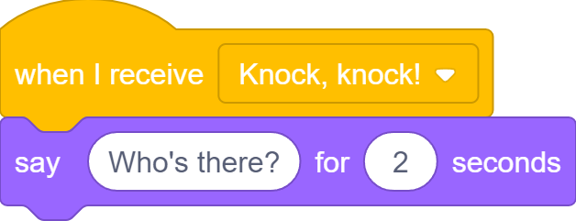
I’m Listening!
Who’s there?
Knock, knock!

Slide 39
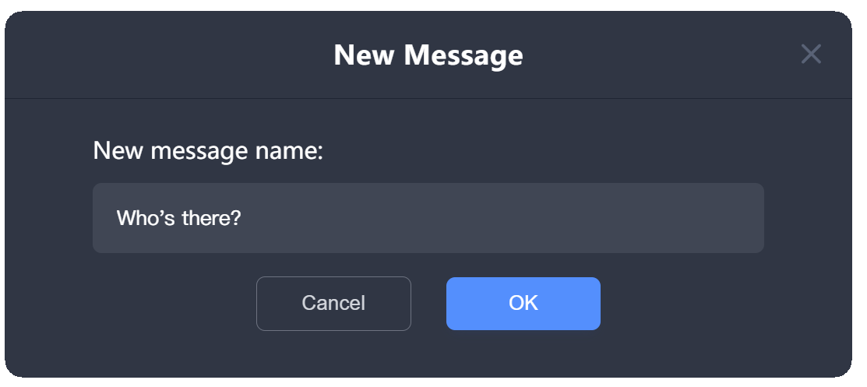
Create ”Who’s There?”

Slide 40
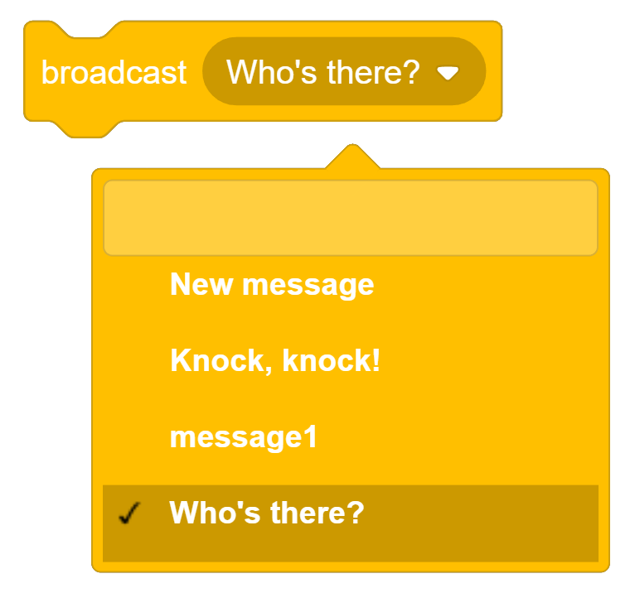
Broadcast “Who’s There?”
New message “Who’s there?” has been created and can be broadcasted back to Dino1

Slide 41
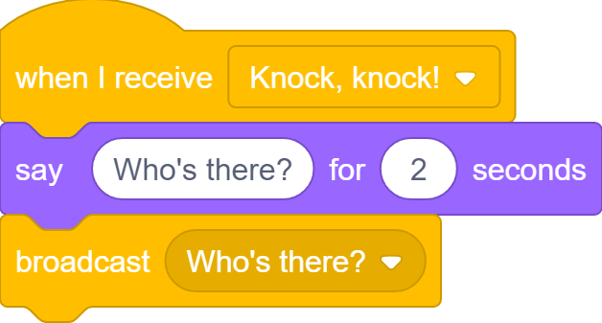
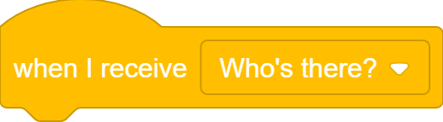
I’m Listening!
I’m ready to receive your “Knock, knock!” message!
Who’s there?

Slide 42
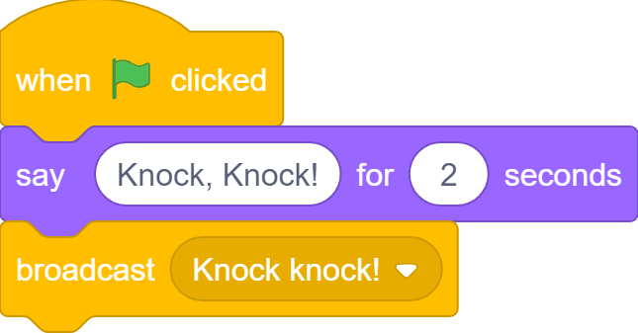
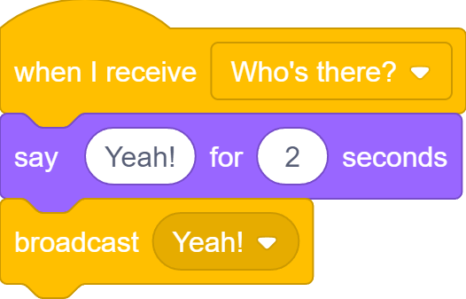
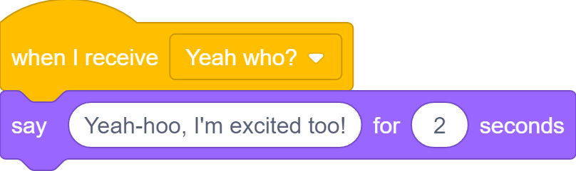

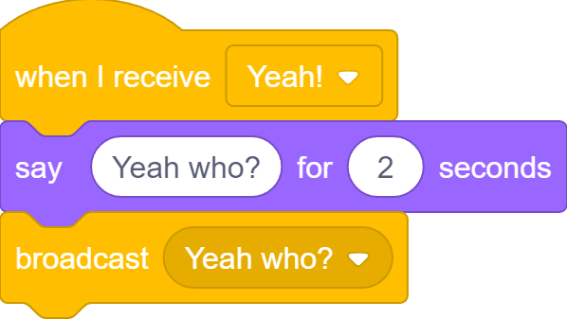
Complete Joke With Broadcasting
Yeah-hoo! I’m excited too!
Knock, knock!
Yeah!
Who’s there?
Yeah who?

Slide 43
What we learnt…
What “Knock, knock” jokes are

Slide 44
What we learnt…
How to create a conversation between two sprites using Say-and-Wait
Knock,
knock!
Who’s
there?

Slide 45
What we learnt…
Two kinds of message exchange: one-to-one and broadcasting

Slide 46
What we learnt…
How to broadcast messages in Scratch

Slide 47
What we learnt…
How to receive messages in Scratch

Slide 48
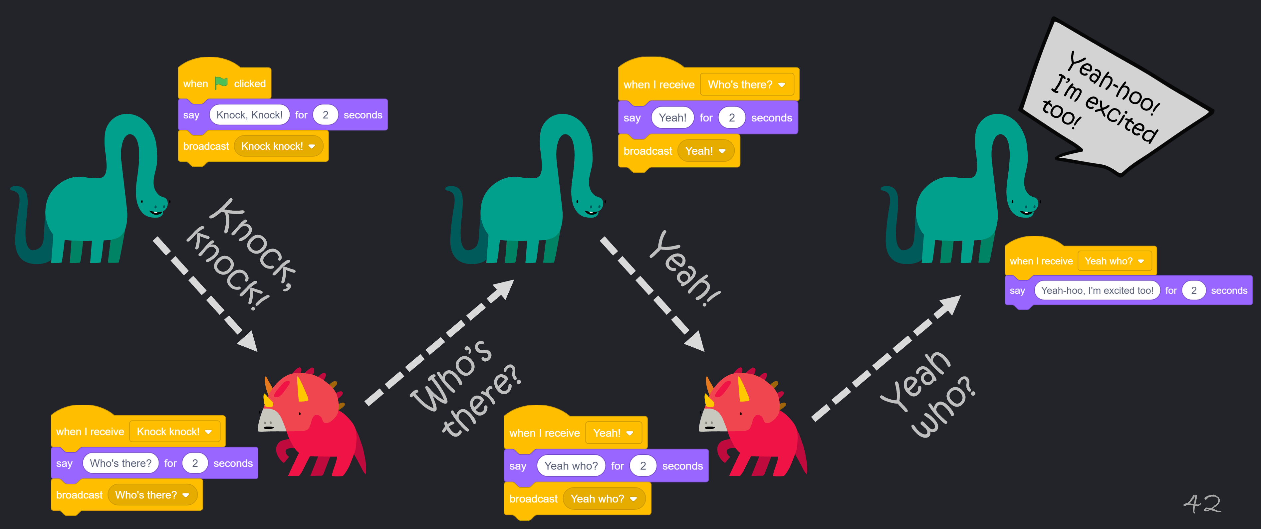
What we learnt…
How to create a REAL conversation between two sprites using Broadcasting

Slide 49
Exercises
As we know, a sprite can receive its own broadcasted message. What would happen if a sprite broadcasts the same message again after receiving it?
How is the “broadcast and wait” block different from the “broadcast” block. Can you make use of it in the “Knock, knock” joke? If so, how is that different from just using “broadcast”? Is this better or worse?

Slide 50
Exercises
Can you find more real-world examples of one-to-one communication and message broadcasting?
Create a longer conversation (could be a different joke or even a whole story) between more than two sprites. Use the Say-and-Wait approach first, then use Message Broadcasting. Compare the two approaches and truly appreciate why message broadcasting makes your life easier.

Slide 51
Thank you and see you in the next lesson!

